Slide 1

Team
OSAMA
ZAMMAR
MOHAMMAD
ABO ALFOUL
OBAIDA
AMMAR

Slide 2


Introduction
The proposed solution ‘University management system’ is a desktop application which focuses on managing ‘STUDENTS’ , ‘INSTRUCTORS’ and ‘COURSES’ in the Faculty of Science.

Slide 3
Users involved
1) Faculty Administrator
2) Instructors
3) Students
DESIGN PATTERNS USED
MVC: used throughout the entire project.
DAO: found in DAO folder.
Singleton: used for Database connection in Database folder.
Abstract Factory: found in Factory Folder and used in the files of the Controller folder.
Flyweight: found in FactoryProducer class in the Factory folder.
Generics used
Array List : used to get List of (Courses) or (University Member : Student or Instructor).
2) HashMap : used to get (Instructor Full Name) and (Instructor Id)
Key: “fullName” Value: “Instructor Full Name”
Key: “Id” Value: “Instructor Id”

Slide 4
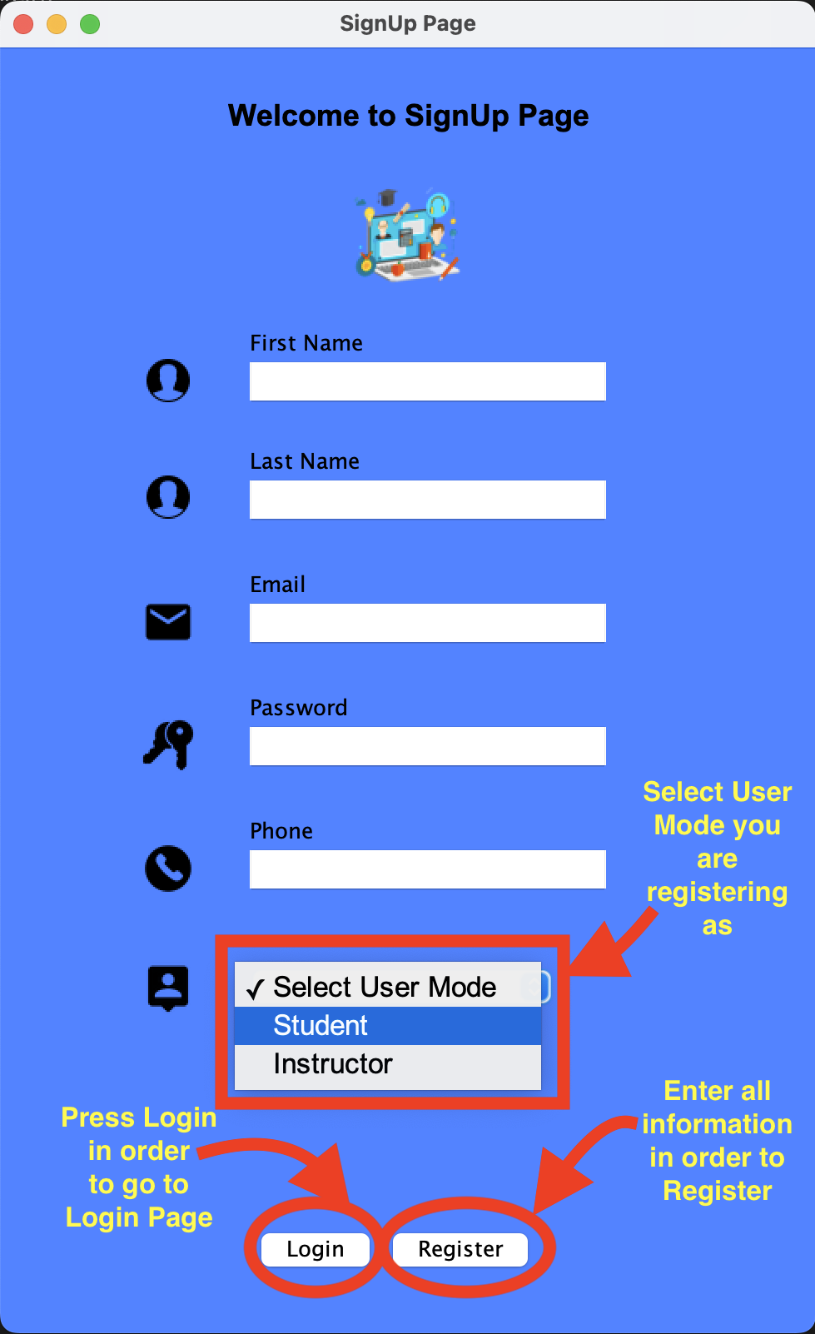
Registration Page
For registration, user must provide all requested information and must specify whether he/she is a ‘Student’ or ‘Instructor’.

Slide 5
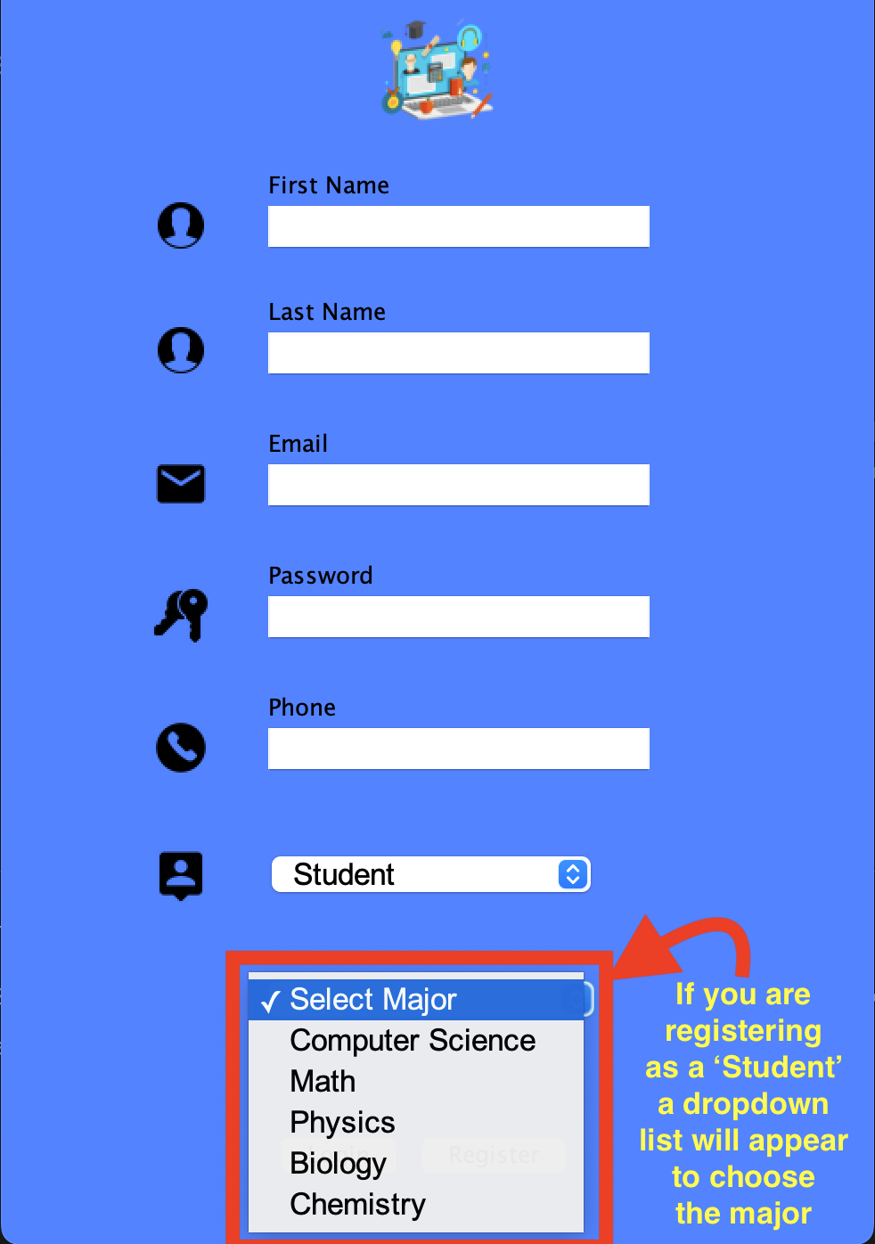
Registration Page Student Mode
A user registering as a ‘Student’ must specify the major he/she applying for

Slide 6
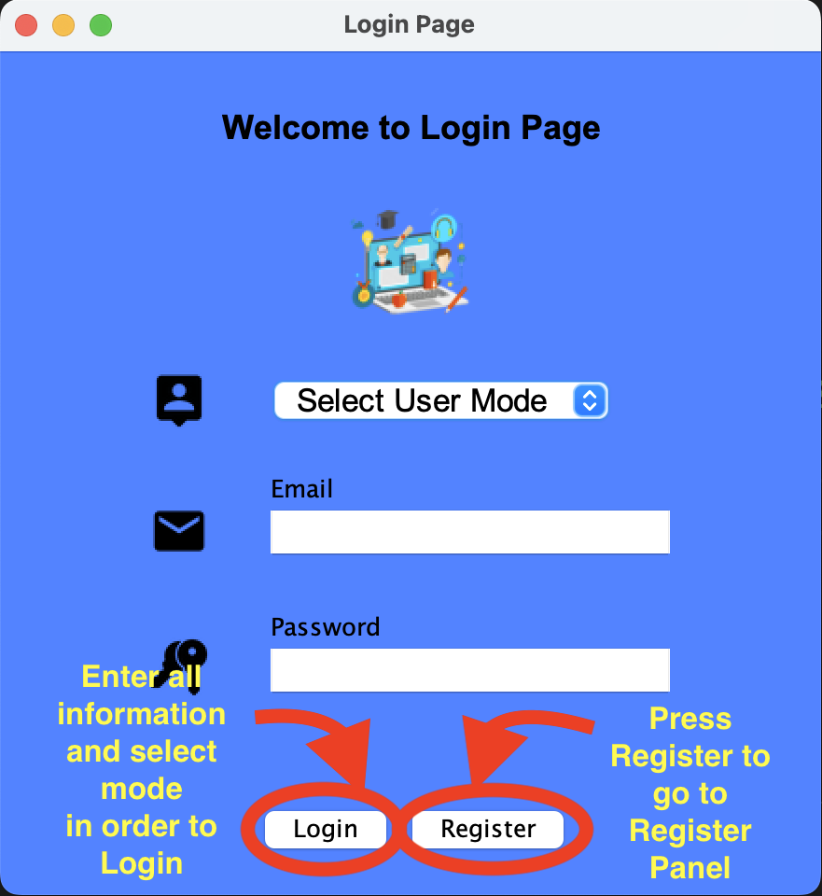
Login Page
A user will be able to login to the system if he/she already accepted by an administrator before. Users must login using their email and password and specifying whether they are ‘Student’ ‘ Instructor’ or ’Administrator’

Slide 7
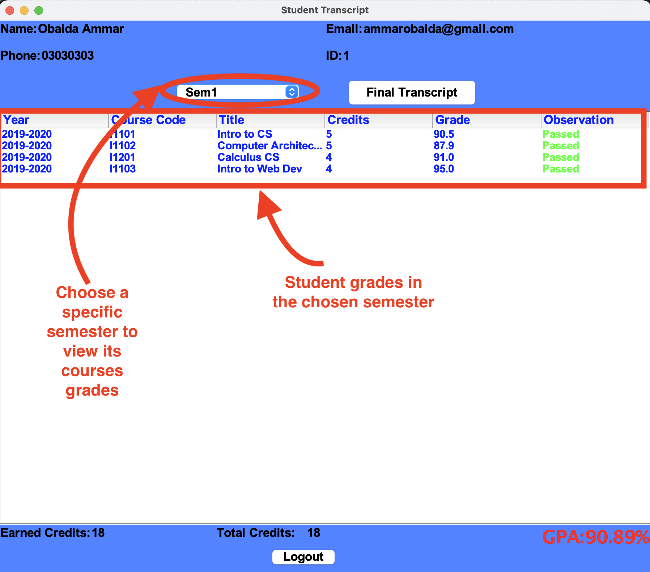
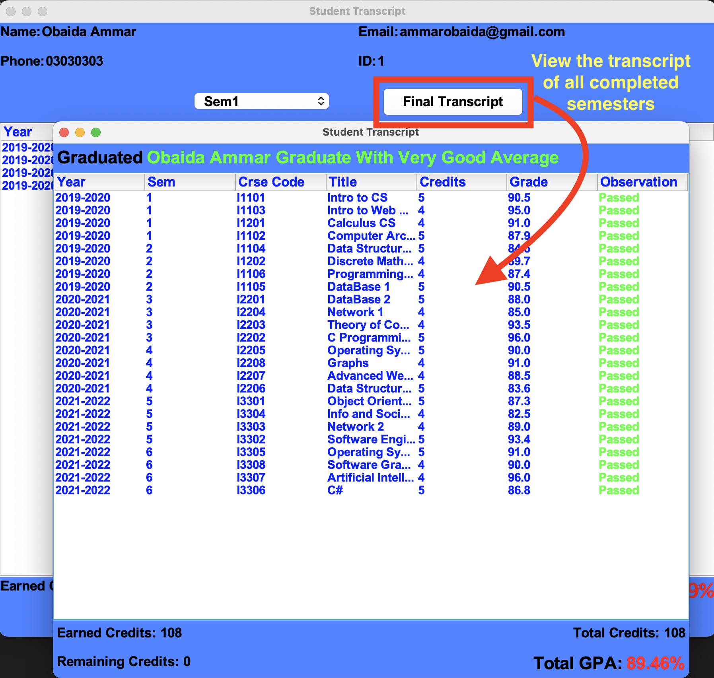
Student Page
Student can view his grades in the chosen semester as well as generate a final transcript

Slide 8
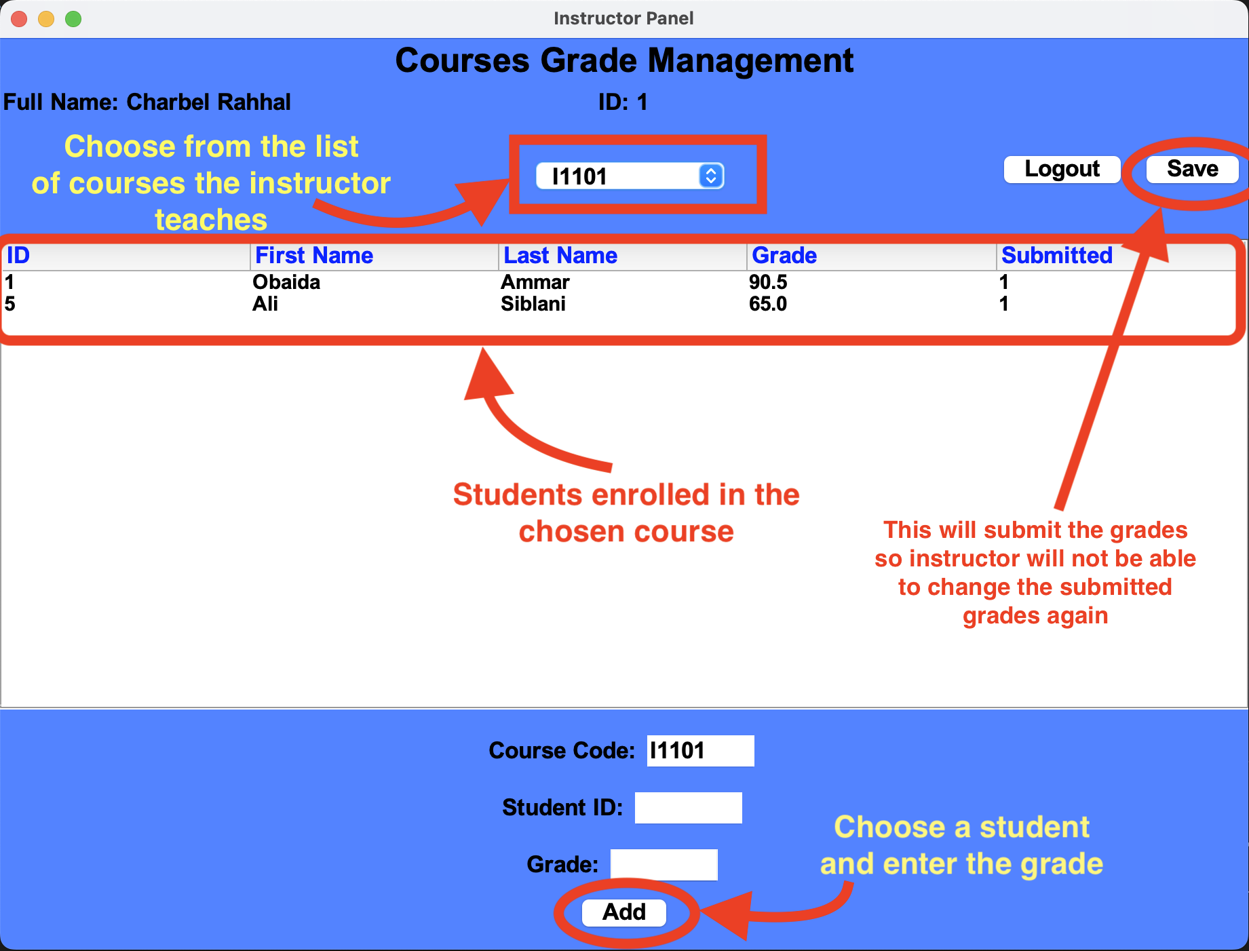
Instructor Page
An instructor will be able to view students grades in the courses he/she teaches. Instructor will be able to assign grades for students, but once the grades are submitted, the instructor will not be able to edit the grades again

Slide 9
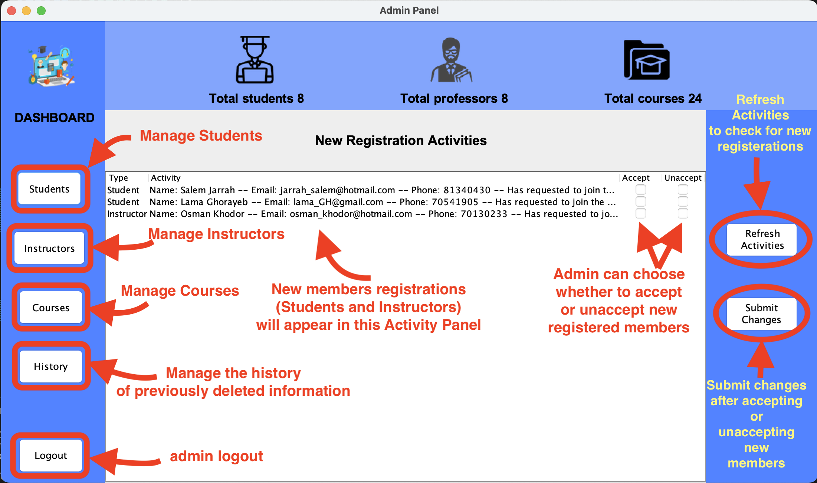
Admin Page
An admin will be able to manage (Students) (Instructors) (Courses) (History) and the registrations of new members (Students and Instructors)

Slide 10
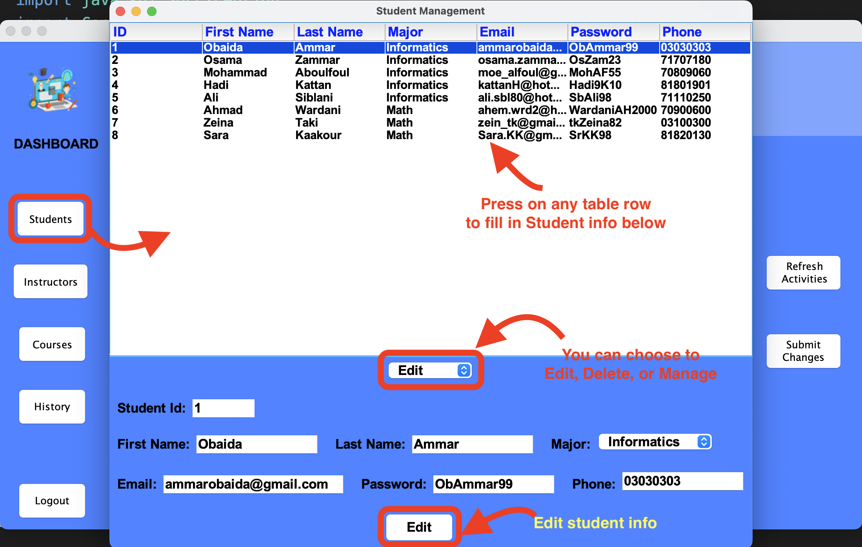
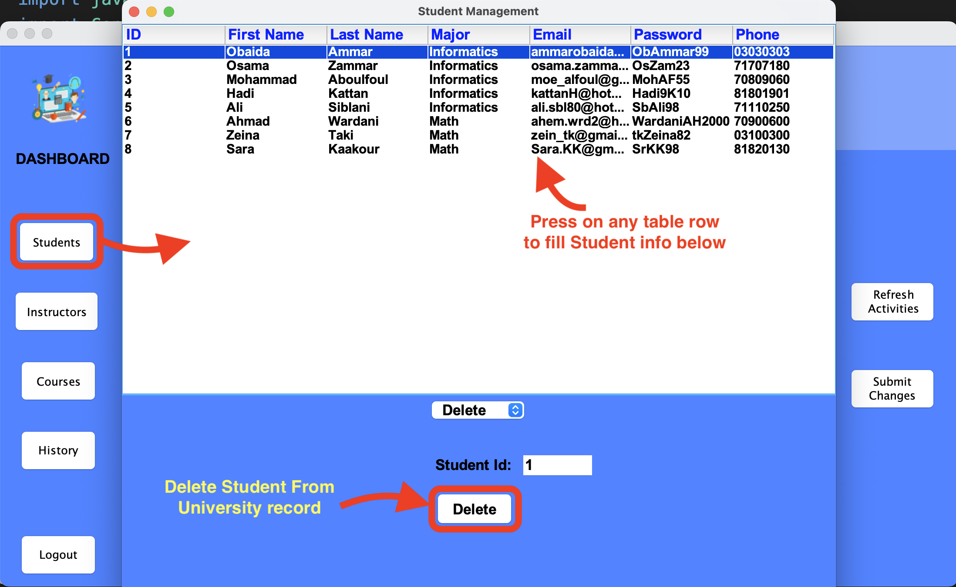
Admin Student Management (Edit – Delete)
An admin will be able to (Edit) student
Info
An admin will be able to (Delete) student
from University Records

Slide 11
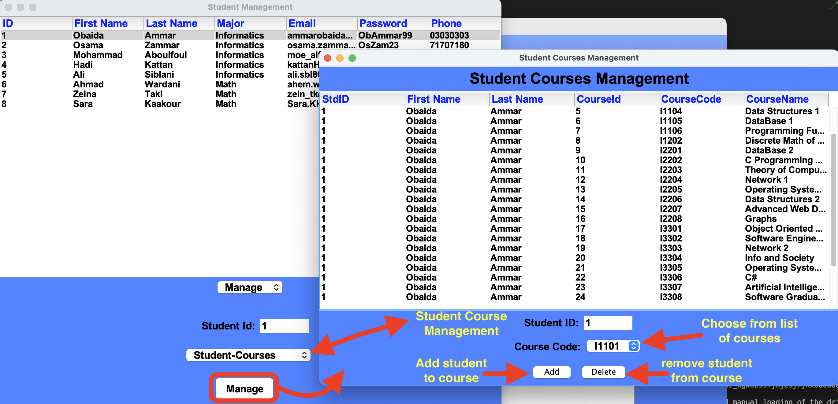
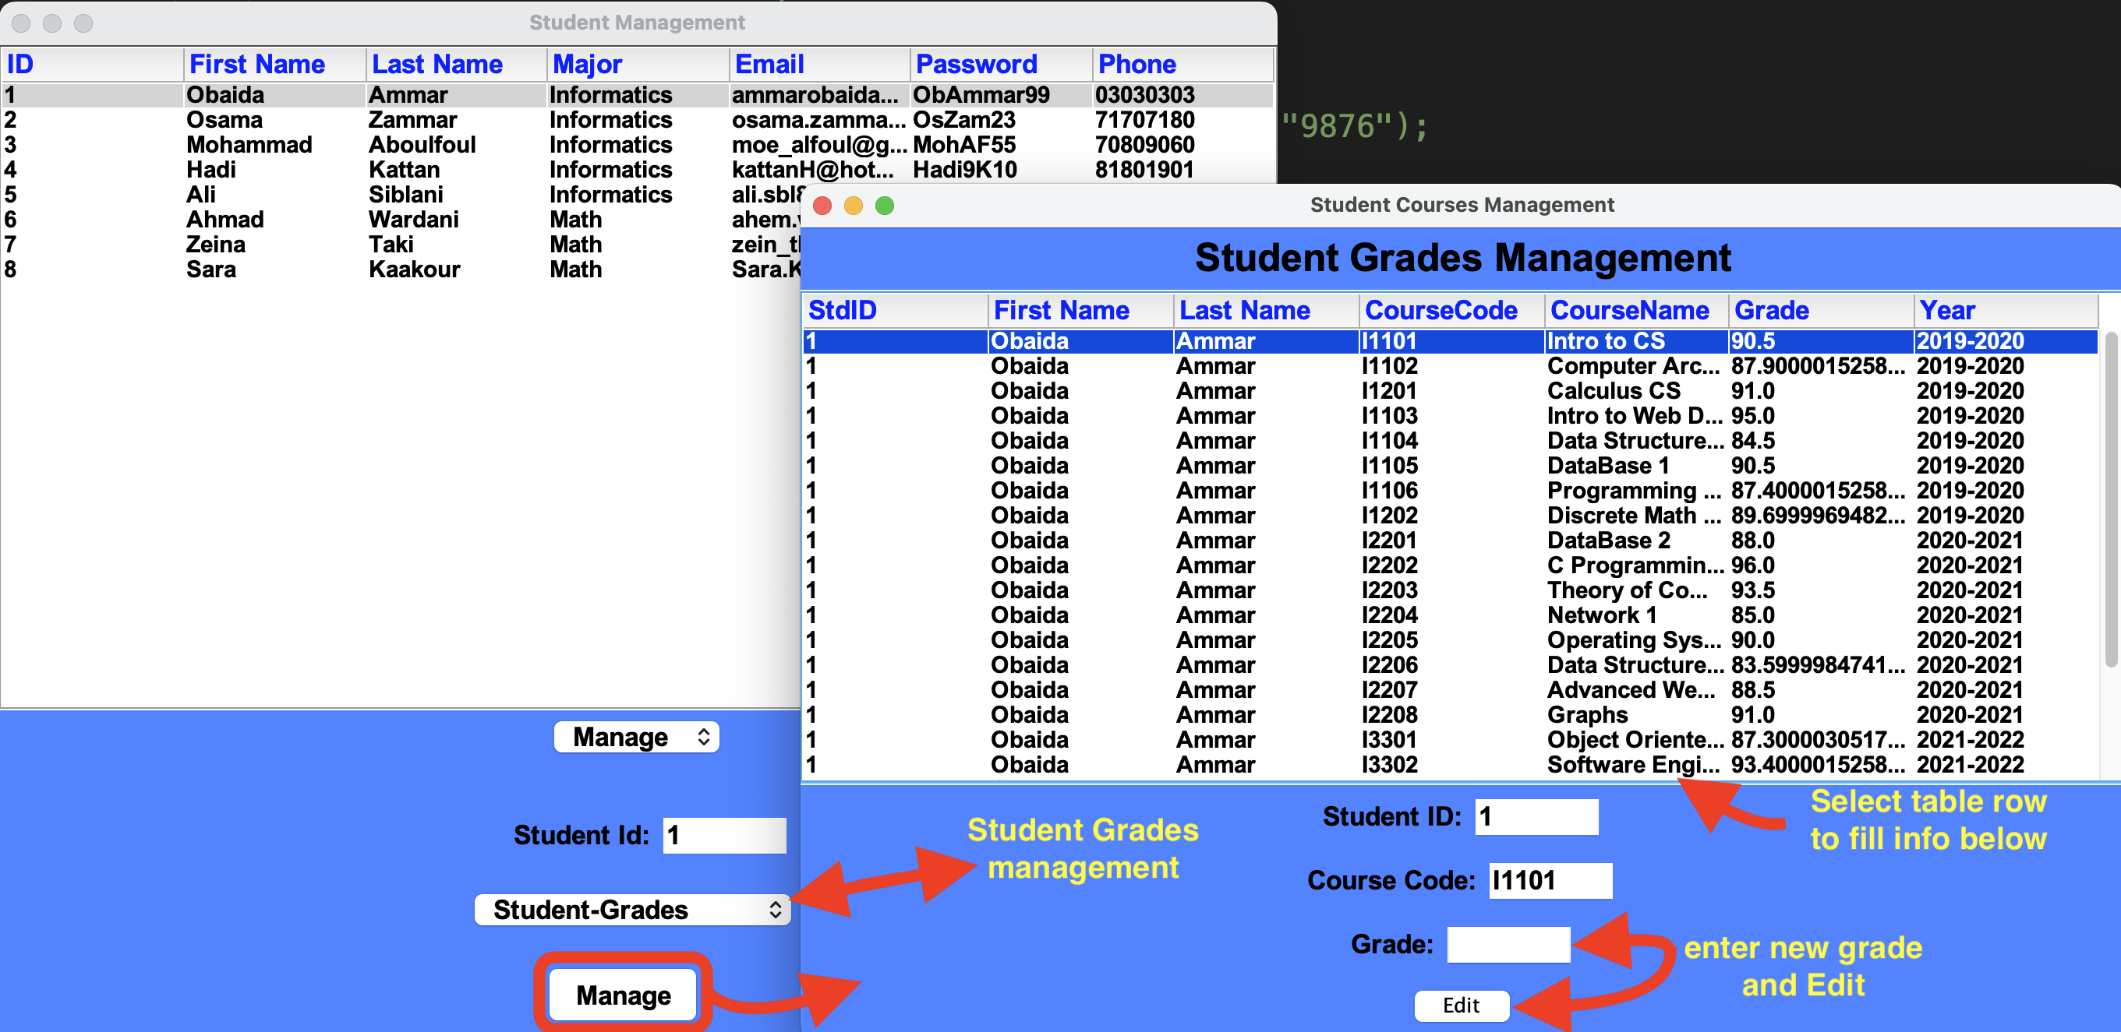
Admin Student Management
An admin will be able to manage:
1) Student – course : Enroll student in course or
remove student from course.
2) Student – grades : Edit student grades in courses

Slide 12
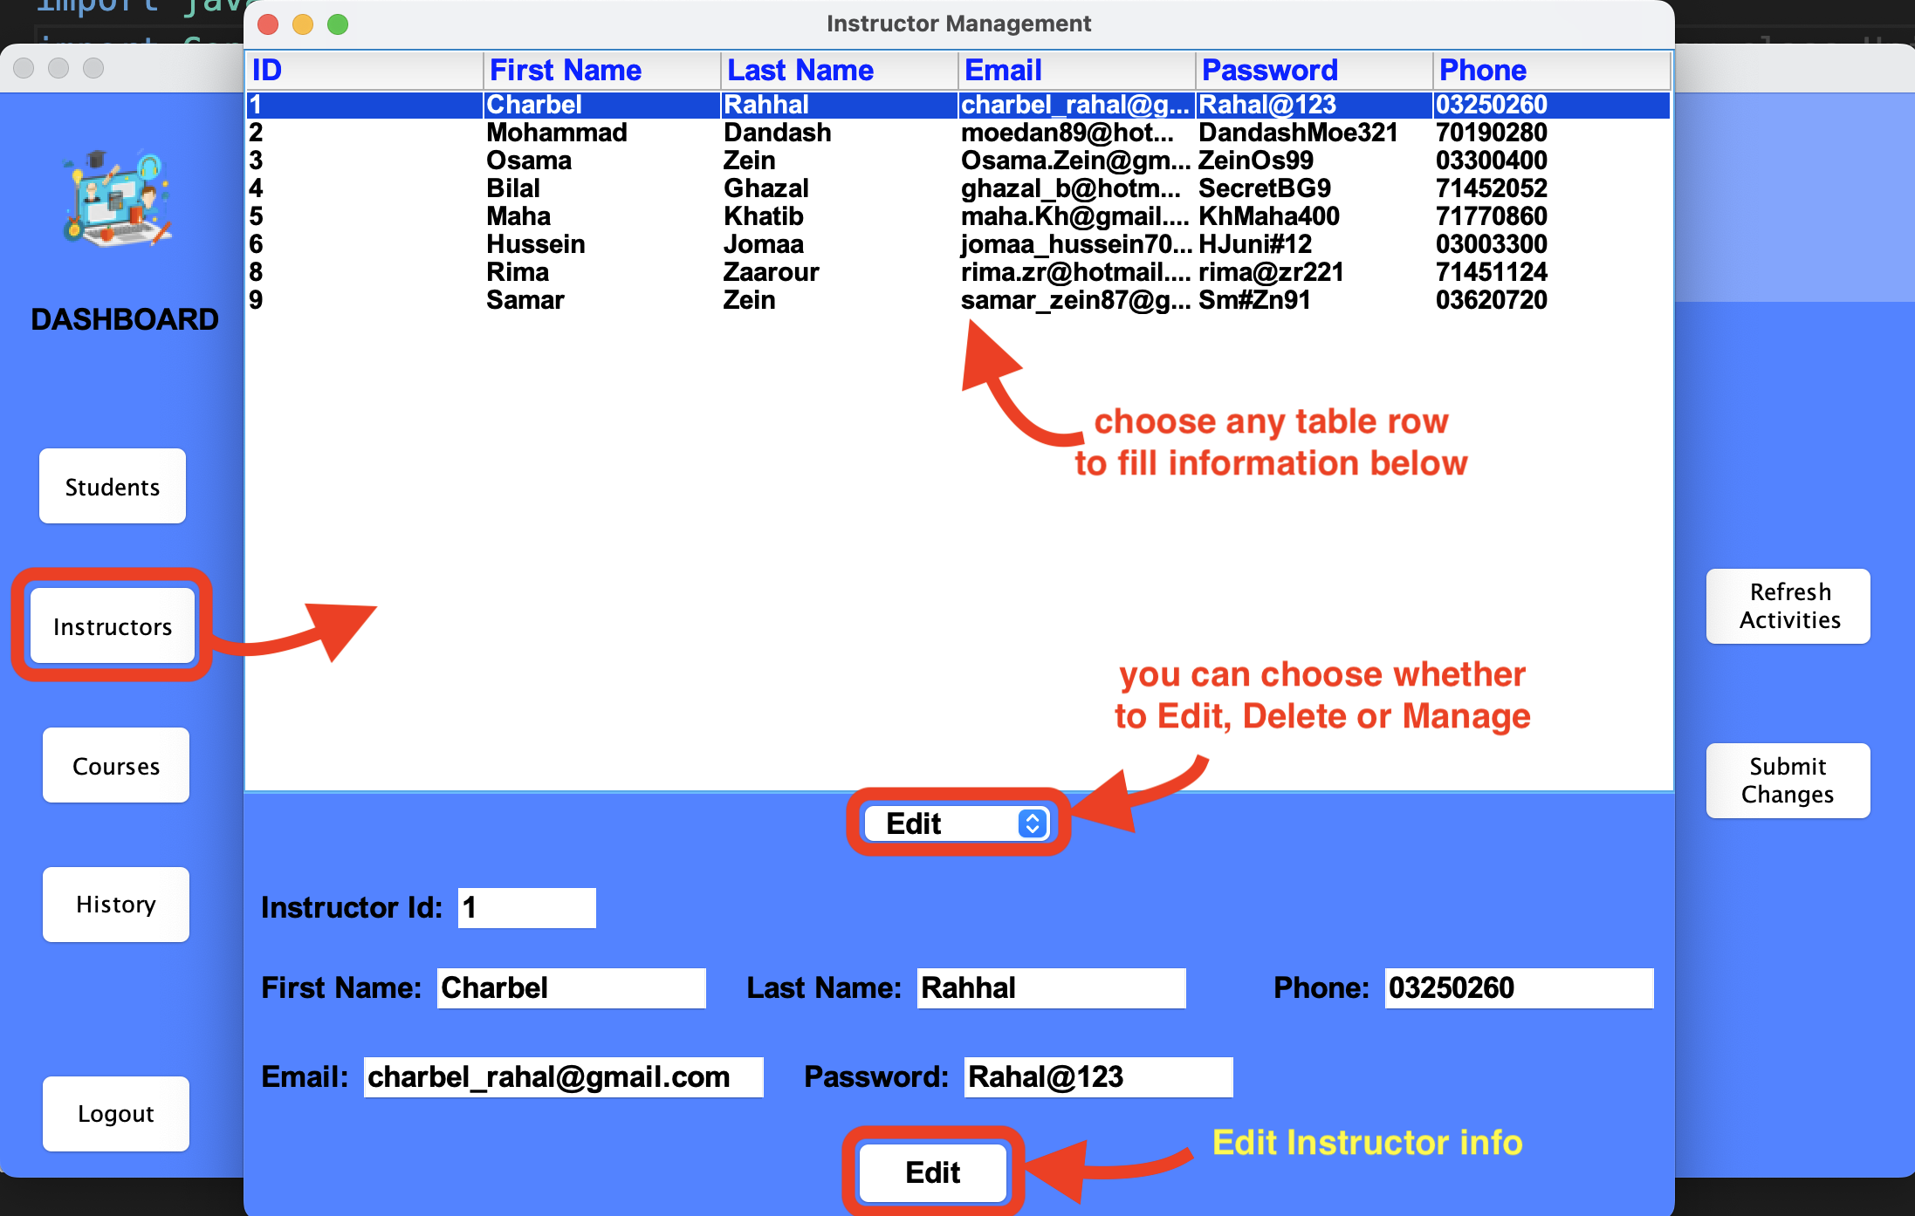
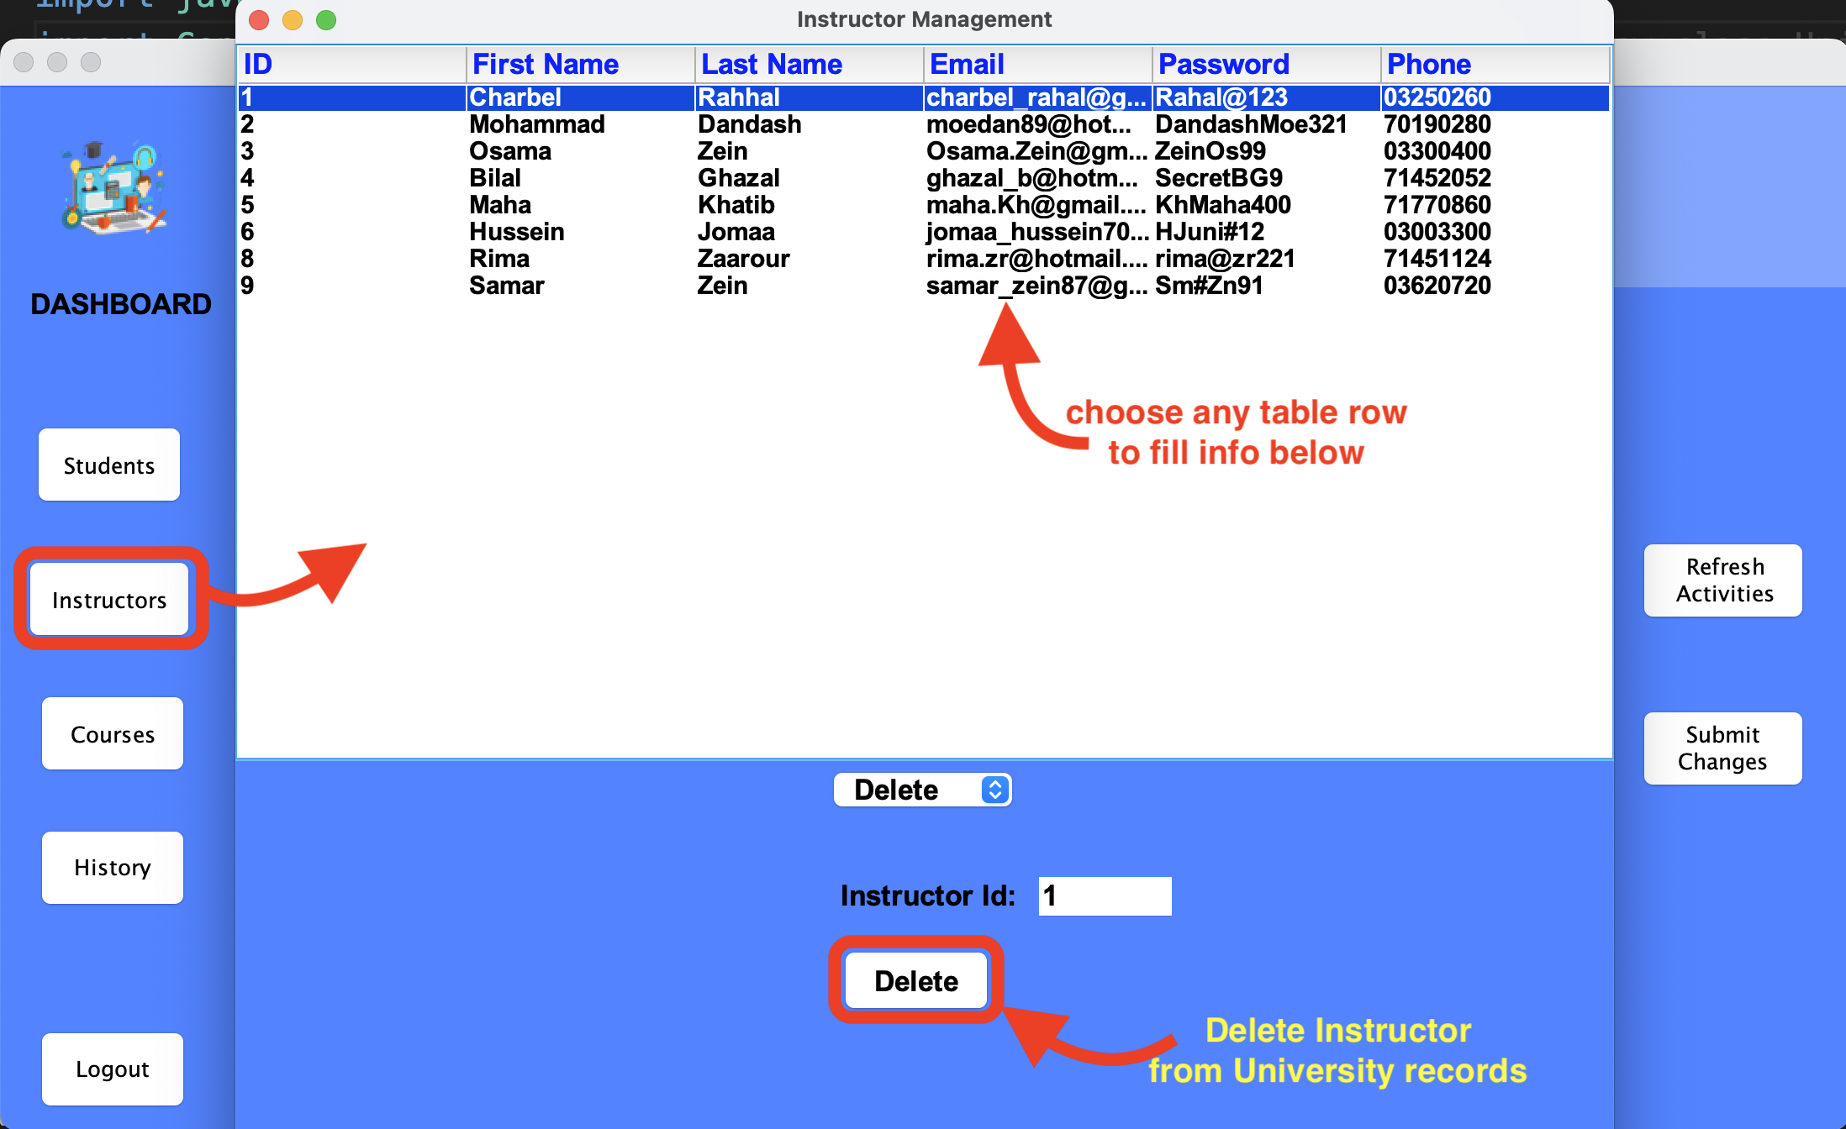
Admin Instructor Management (Edit-Delete)
An admin will be able to (Edit) instructor info
An admin will be able to (Delete) instructor from University Records.

Slide 13
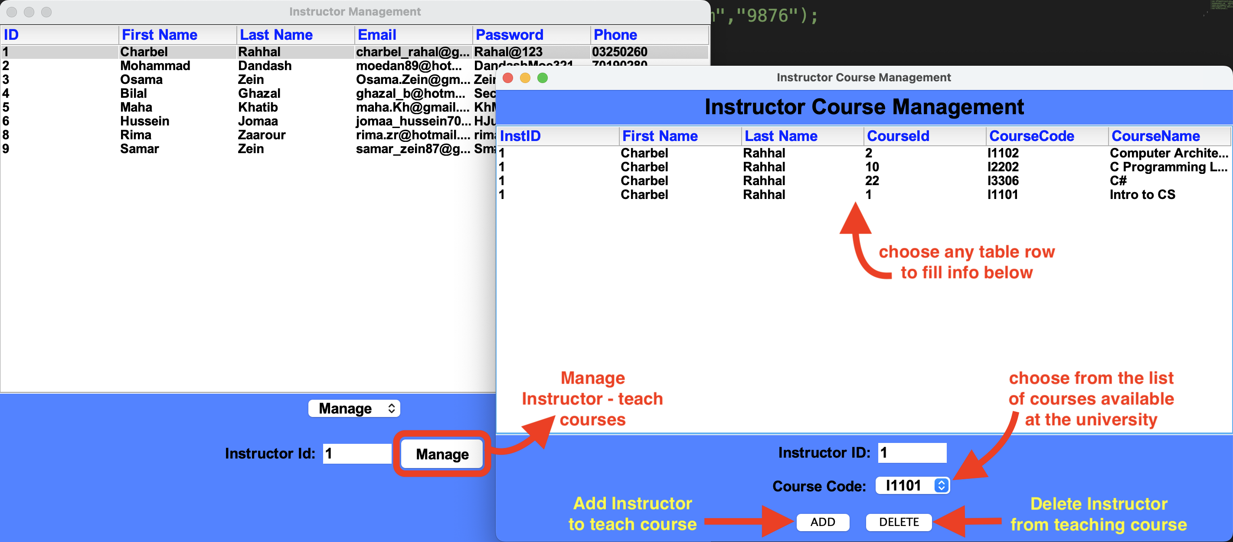
Admin Instructor Management
An admin will be able to manage instructor assignment to course
Add instructor to teach course
Remove instructor from teaching course

Slide 14
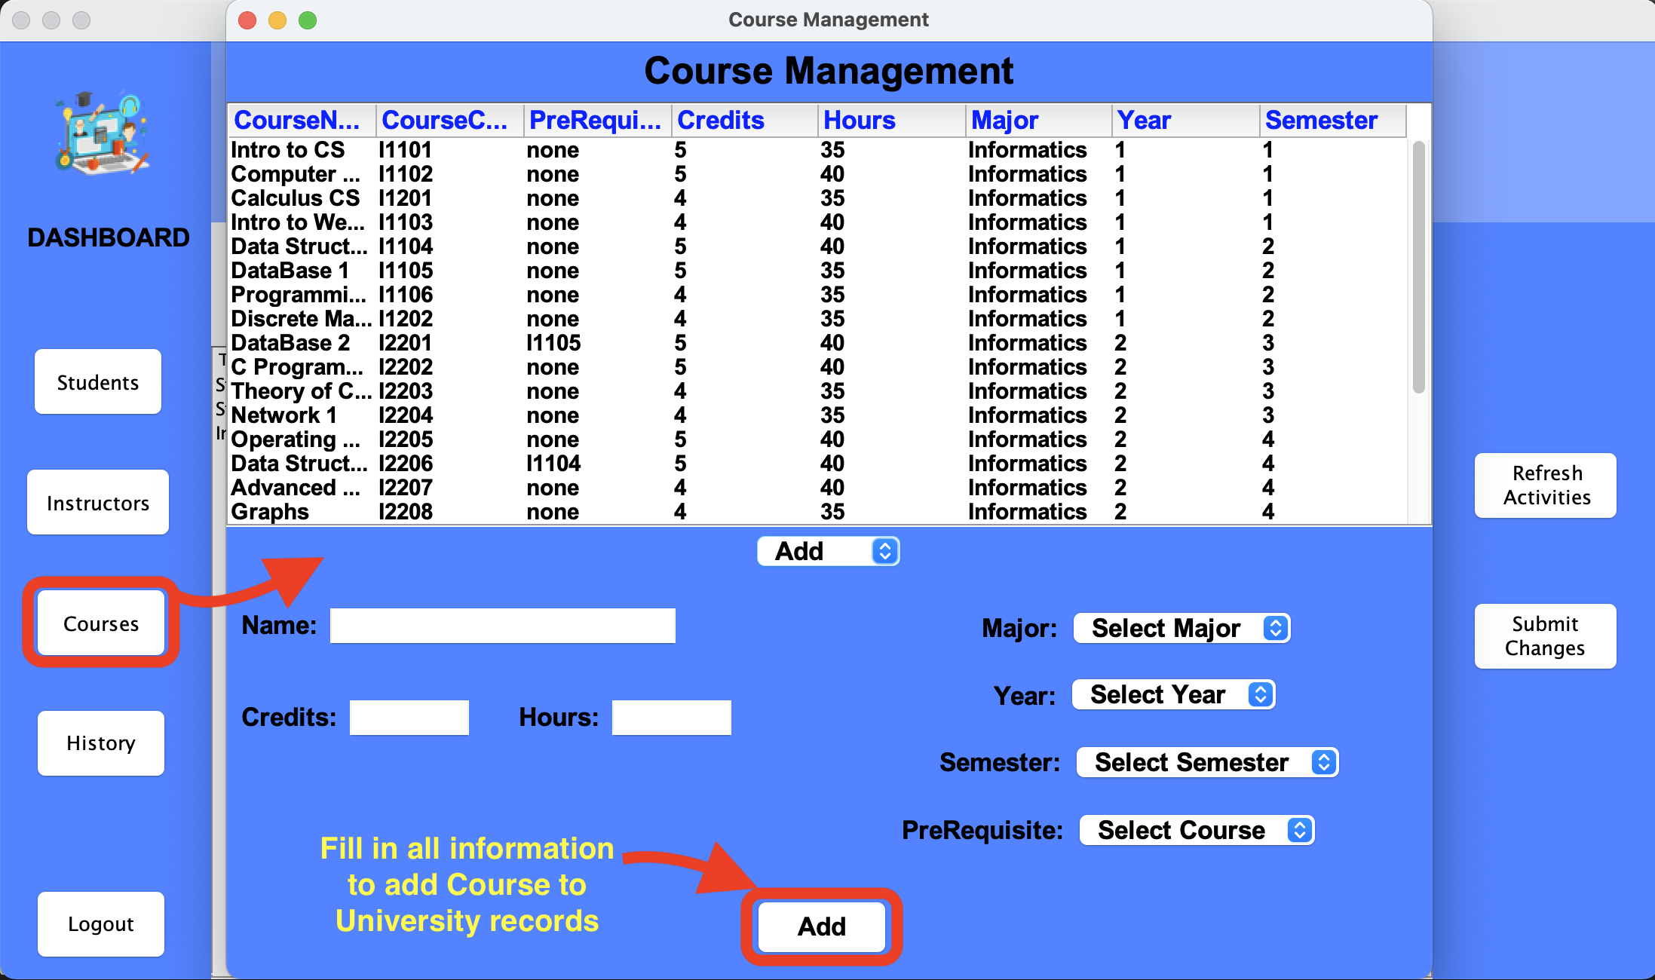
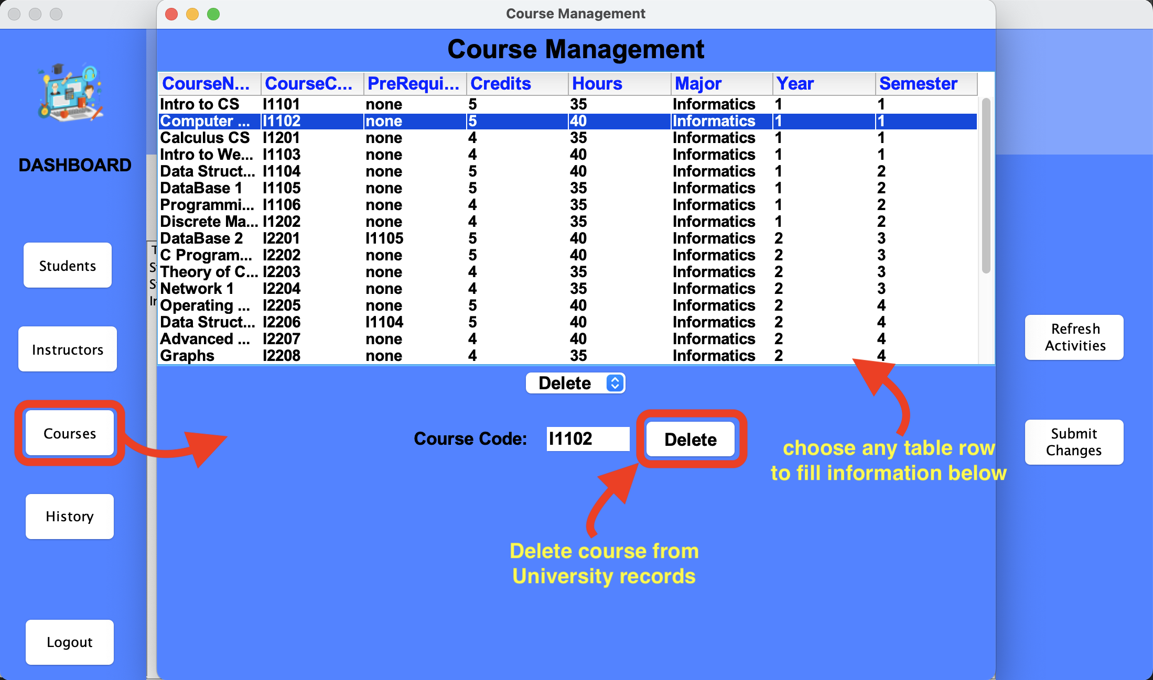
Admin Courses Management
An admin will be able to (Add) course.
An admin will be able to (Delete) course.

Slide 15
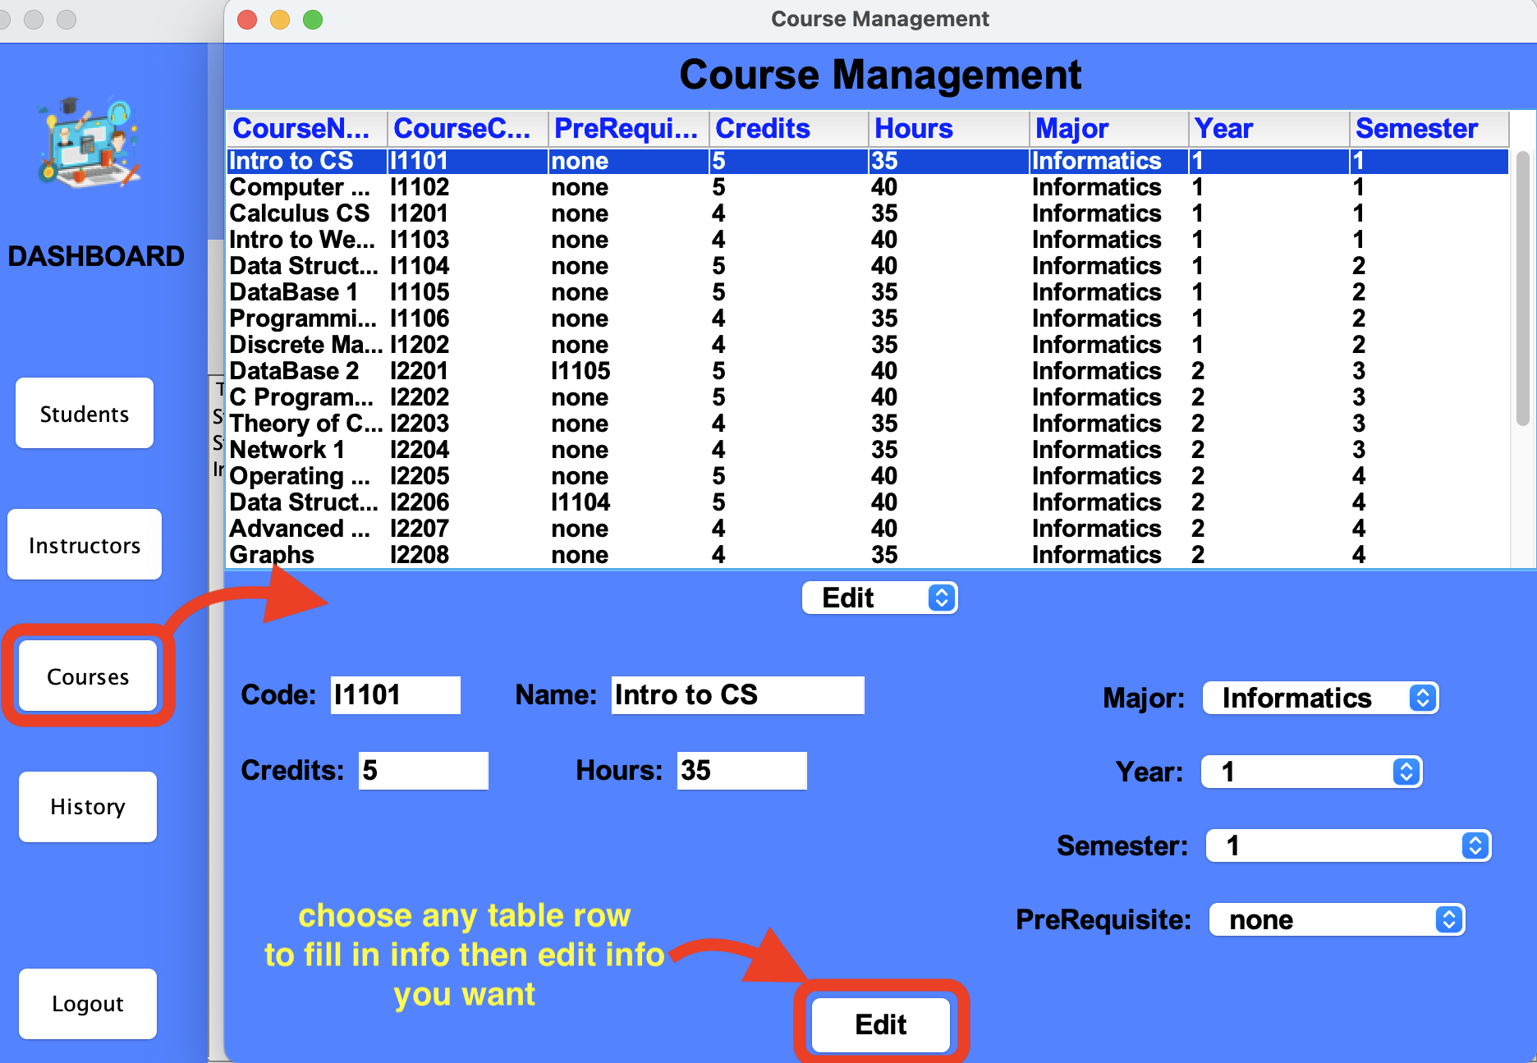
Admin Course Management
An admin will be able to (Edit) course details

Slide 16
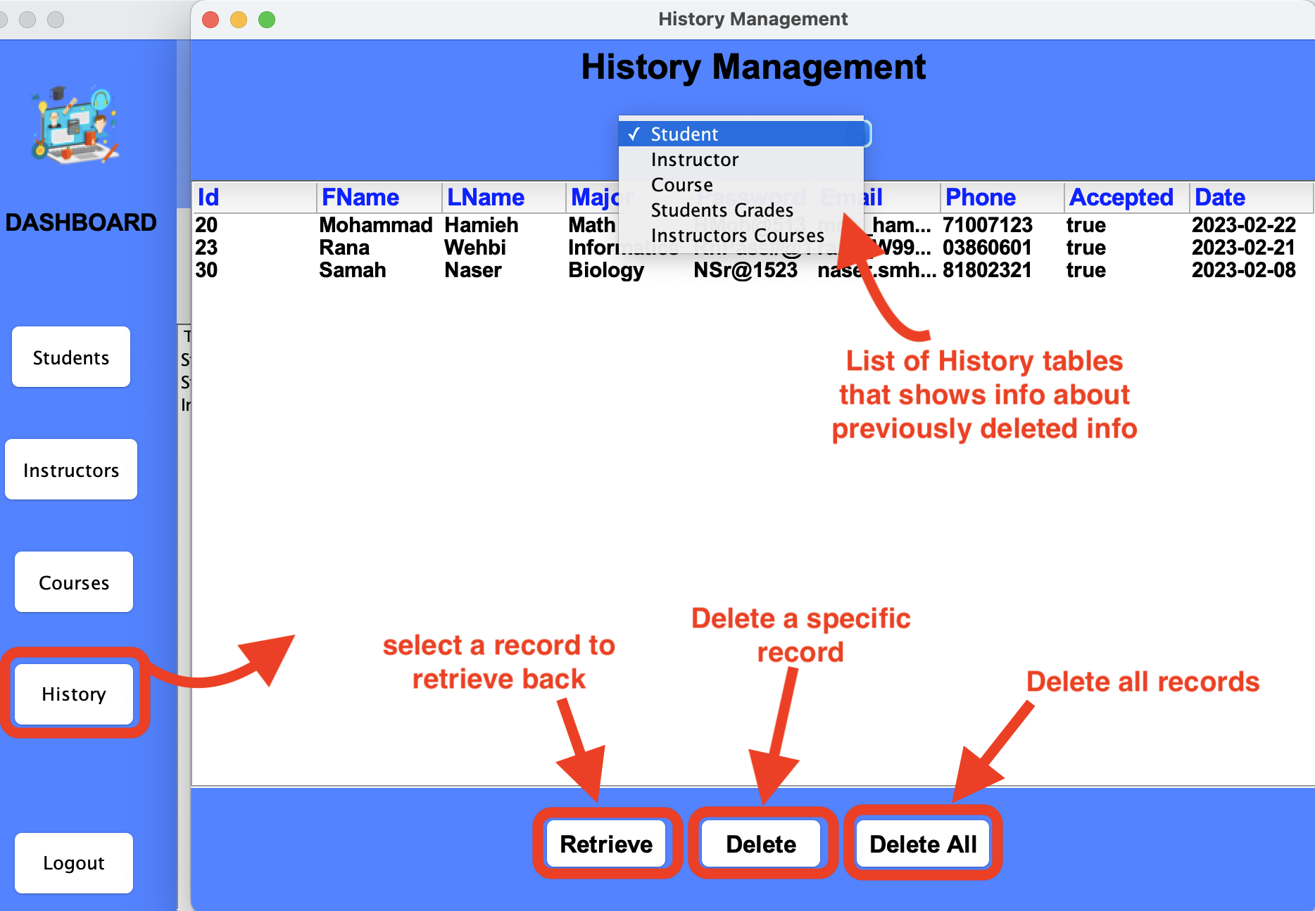
Admin History Management
An admin will be able to manage the history of previously deleted (Students, Instructors, Courses, Grades, Instructor-Courses relations)

Slide 17



Summary
All universities need a system to manage the activities of the university. It automates the registration of student’s – instructor’s processes in University. It reduces the time it takes to register student’s courses and checking the courses prerequisites, grades and average calculations. This software is responsible for entering student’s data and keeping it from the day of submission till the student graduates, so it processes and maintains student’s data, major and marks. In addition, it maintains instructors data and their assignments to teach courses and permit them to assign grades to students in the courses they teach. An administrator, is responsible for managing all activities of students-instructors-courses.

Slide 18




Thank you

